Slide 1
Defining user Requirements & Validating Requirements
DEPARTMENT OF CSE COURSE NAME – ADAPTIVE Software Engineering
COURSE CODE – 22CI2001
Session -9

Slide 2




AIM OF THE SESSION
To familiarize students with the basic concept of Types of elements of the Requirements, Negotiating and Validating Requirements & Importance, Validation Techniques.
INSTRUCTIONAL OBJECTIVES
This Session is designed to:
Demonstrate Types of elements of the Requirements,
Describe the Negotiating Requirements
Describe the Validating Requirements & Importance,
Describe the Validation Techniques
LEARNING OUTCOMES
At the end of this session, you should be able to:
Demonstrate different Types of elements of the Requirements,
Describe the Negotiating Requirements
Describe the Validating Requirements & Importance,
Describe the Validation Techniques

Slide 3
SESSION INTRODUCTION
AGENDA
Types of elements of the Requirements
Negotiating Requirements
Validating Requirements & Importance
Validation Techniques

Slide 4
TYPES OF ELEMENTS OF THE REUIREMENTS
The specific elements of the requirements model are dictated by the analysis modeling method that is to be used. However, a set of generic elements is common to most requirements models.
Scenario-based elements
Class-based elements
Behavioral elements
Flow-oriented elements
Analysis patterns

Slide 5
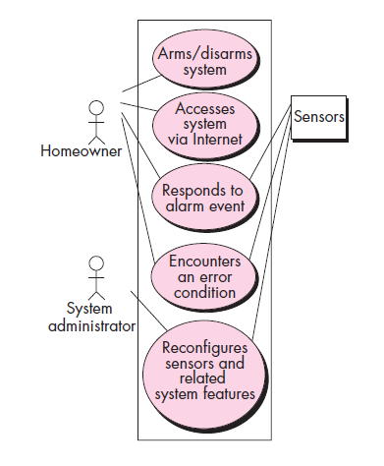
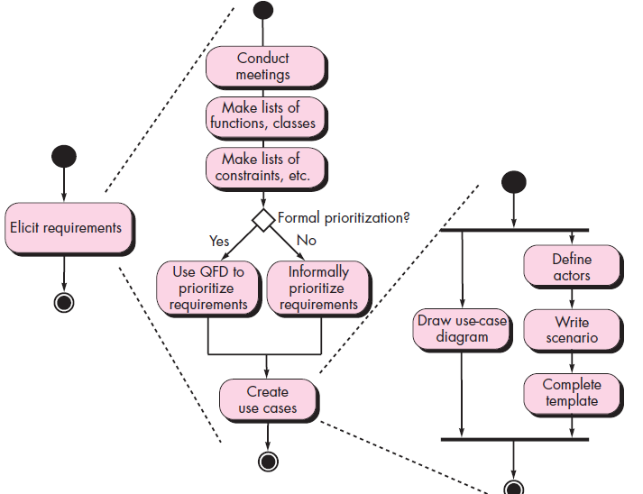
Scenario-based elements
Activity Diagram for eliciting requirements
Use Case Diagram for Safe home

Slide 6
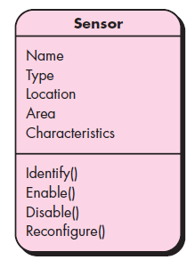
Class-based elements
Class Diagram for Sensor

Slide 7
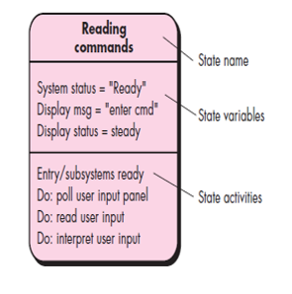
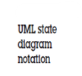
Behavioral Elements

Slide 8
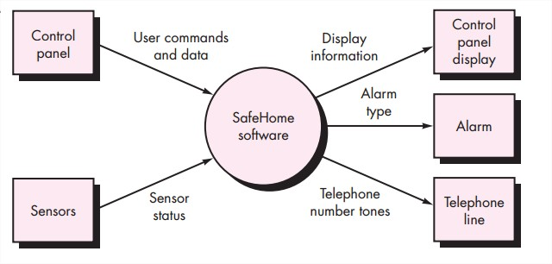
Flow – Oriented Elements
Information is transformed as it flows through a computer-based system.
The system accepts input in a variety of forms; applies functions to transform it; and produces output in a variety of forms.

Slide 9
Analysis Patterns
Anyone who has done requirements engineering on a number of software projects will note that some issues repeat across all projects within a certain application area. These patterns of analysis provide solutions (e.g., a class, a function, or a behavior) inside the application domain that can be reused when modelling several applications.
By referencing the pattern name, analysis patterns are integrated into the analysis model. They are also stored in a repository so that requirements engineers can find and apply them using search facilities. Information about an analysis pattern (and other sorts of patterns) is contained in a standard template.

Slide 10
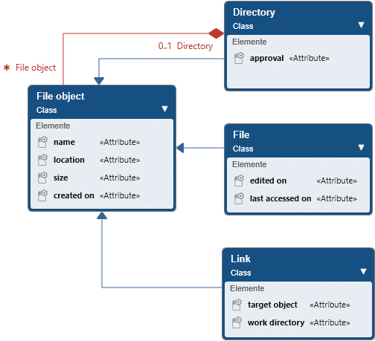
Analysis Patterns

Slide 11
Negotiating Requirements
The inception, elicitation, and elaboration tasks in an ideal requirements engineering setting determine customer requirements in sufficient depth to proceed to later software engineering activities.
Boehm [Boe98] defines a set of negotiation activities at the beginning of each software process iteration. Rather than a single customer communication activity, the following activities are defined:
Identification of the system or subsystem’s key stakeholders.
Determination of the stakeholders’ “win conditions.”
Negotiation of the stakeholders’ win conditions to reconcile them into a set of win-win conditions for all concerned (including the software team).

Slide 12
Validating Requirements & Importance
Requirements validation is the process of checking that requirements define the system that the customer really wants.
It overlaps with elicitation and analysis, as it is concerned with finding problems with the requirements.
Requirements validation is critically important because errors in a requirements document can lead to extensive rework costs when these problems are discovered during development or after the system is in service.
The cost of fixing a requirements problem by making a system change is usually much greater than repairing design or coding errors.

Slide 13
Validating Requirements & Importance
A change to the requirements usually means that the system design and implementation must also be changed
Furthermore, the system must then be retested.
Concerned with demonstrating that the requirements define the system that the customer really wants.
Requirements error costs are high so validation is very important
Fixing a requirements error after delivery may cost up to 100 times the cost of fixing an implementation error.

Slide 14
Verification designing the product right Validation designing the right product The formality gap validation will always rely to some extent on subjective means of proof Management and contractual issues design in commercial and legal contexts
Validating Requirements
Real-world requirements and constraints
The formality gap

Slide 15
Validating Requirements
In the Validation process few questions should be asked and answered to ensure that the requirements model is an accurate reflection of stakeholder needs and that it provides a solid foundation for design.
Each aspect of the requirements model is checked for consistency, omissions, and ambiguity as it is developed. The model’s requirements are prioritised by stakeholders and bundled into requirements packages that will be implemented as software increments.

Slide 16
Validating Requirements
During the requirements validation process, different types of checks should be carried out on the requirements in the requirements document.
These includes
Validity checks
Does the system provide the functions which best support the customer’s needs?
Consistency checks
Are there any requirements conflicts?
Completeness checks
Are all functions required by the customer included?
Realism checks
Can the requirements be implemented given available budget and technology
Verifiability
Can the requirements be checked

Slide 17
Validation Techniques
A number of requirements validation techniques can be used individually or in conjunction with one another.
Those includes
Requirements reviews
Systematic manual analysis of the requirements.
Prototyping
Using an executable model of the system to check requirements.
Test-case generation
Developing tests for requirements to check testability

Slide 18
SELF-ASSESSMENT QUESTIONS
Define Types of elements of the Requirements.
Write a short note on: Negotiating Requirements.
Discuss Validating Requirements & Importance.
Define Validation Techniques.

Slide 19
REFERENCES FOR FURTHER LEARNING OF THE SESSION
TEXTBOOKS:
Roger S.Pressman, “Software Engineering – A Practitioner’s Approach” 7th Edition, Mc Graw Hill,(2014).
Ian Sommerville, “Software Engineering”, Tenth Edition, Pearson Education, (2015).
Reference Book
Agile and Iterative Development: A Manager's Guide, Craig Larman, Addison-Wesley
WEB REFERNCES/MOOCS:
https://www.digite.com/kanban/what-is-kanban/
http://www.scaledagileframework.com
https://www.guru99.com/test-driven-development.html
https://junit.org/junit5/

Slide 20
THANK YOU
Team – Adaptive Software Engineering

